Slide 1

Accelerated Reader
An Introduction

Slide 2
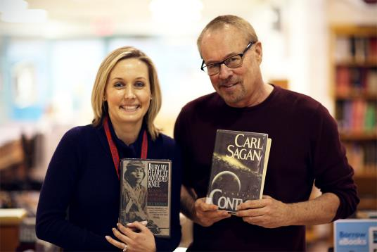
Follow Us on Instagram!
@olmclibrary
Library Closures
What’s Carmel Reading? Staff and Students
Pazin’s Picks and Pans
New Books to the library
Read Alikes
Other interesting info

Slide 3
What is Accelerated Reader?
It is a program that lets you choose the books you want to read
Once you finish reading a book, you take a 10 question multiple choice test on the computer (knowledge based questions)
You earn points based on the book you read and how well you do on your test (60% needed to pass)

Slide 4




What kind of books can I read?
You can read books from any genre
Before you decide to read a book, check arbookfind.com to make sure there is a test for it and also for the number of points a book is worth and the book level

Slide 5

Are there any books I can’t read?
There is a list of blocked books.
Your teacher has been given a copy to post in your classroom. There is also a list posted by Mr. Herod’s desk

Slide 6

How do I take a test?
Come to the library between 7:45 am and 2:45 pm
Bring
  Your student ID
  An AR slip signed by your teacher
  Your novel (if it is from the school library)
  Money to pay for any fines you have incurred
After you finish your test, you will get a print out with your results to take back to your teacher

Slide 7
AR Deadlines
Half of your points are due at midterm. Your teacher will set a specific deadline for your class.
The last day for AR testing is Thursday, December 21st, 2017

Slide 8
FAQs
Can I read my book at home?
  Yes
Does my book have to be from the school library?
  No, your book can be one that you own, from the Mississauga library, an ebook, one that you have borrowed from a friend, etc

Slide 9
Can I re-take a test if I am unsuccessful?
  No. You must read another book and take a test on it.
Do I earn points if I get less than 60% on my test?
  No.

Slide 10

Using the computers
Go to the library circulation desk (where Mr. Herod sits)
Tell us whether you would like a group or individual computer
Give us your student card and we will give you a computer number
Return your computer number when you are finished to get your student card back
Printing is 10 cents a page

Slide 11

Time to find a book!

