Slide 1
Databases …
What are they?
Why do we need them?
How do I access them?

Slide 2
Databases …
are a “non-internet”electronic research option
contain both scholarly and popular sources
eliminate the need for source evaluation (since the academic journal articles they carry, for example, have been peer-reviewed)
cite for you (just click ‘citation tools’ to choose a style)

Slide 3
Accessing Dufferin-Peel Databases …
(there are just over 50 of them to access for all disciplines)
go to Dufferin-Peel homepage
choose “Programs and Services”(green icon on top)
choose “Secondary”(from drop down menu)
choose “Library e-Resources” (from “Quick Links” menu on bottom left)
choose “Secondary Library e-Resources”(choose General or Subject Specific – both are good ones)
(Typing “Library e-Resources” in the search bar from the Dufferin-Peel homepage
will also work)

Slide 4
If away from school, use these passwords …
(they are listed outside library doors)
Database Name/s | Username | Password
All databases | N/A | duffpeel
Brittanica | duffpeel | duff7878
NoveList | dpcdsb | duffpeel

Slide 5
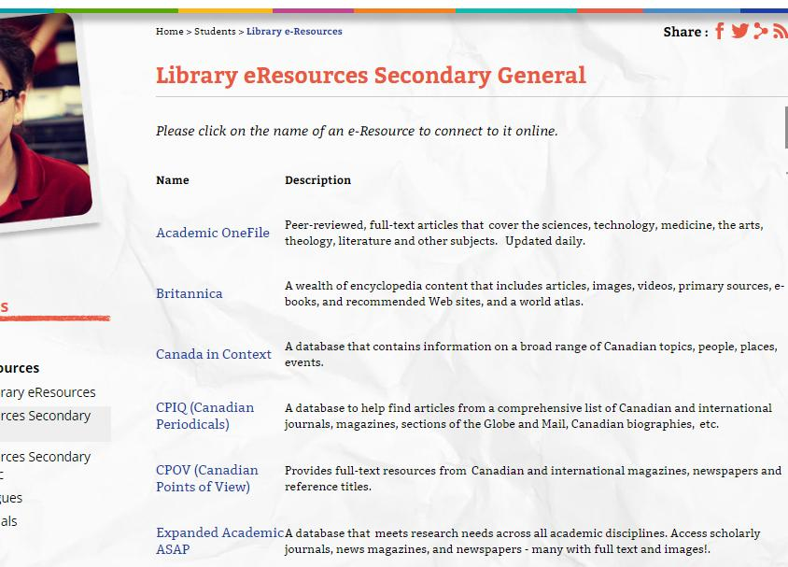
First, you will see a listing of databases: these are a few of the “Secondary General” Databases …
(Academic OneFile is highlighted: we will go into that next)

Slide 6
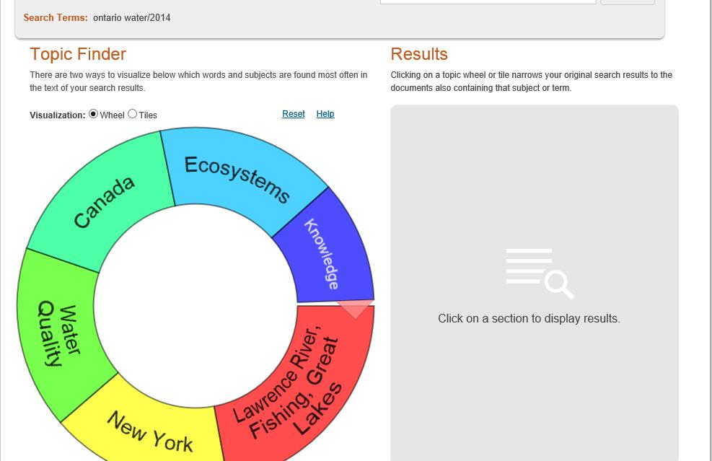
Inside ‘Academic One File’ …
The topic finder feature is useful. Type in your key word/s and click “wheel” or “tile”.
Key words are an important part of the search.
* Below is a search to find out about water quality status in Ontario’s First Nation communities.

Slide 7
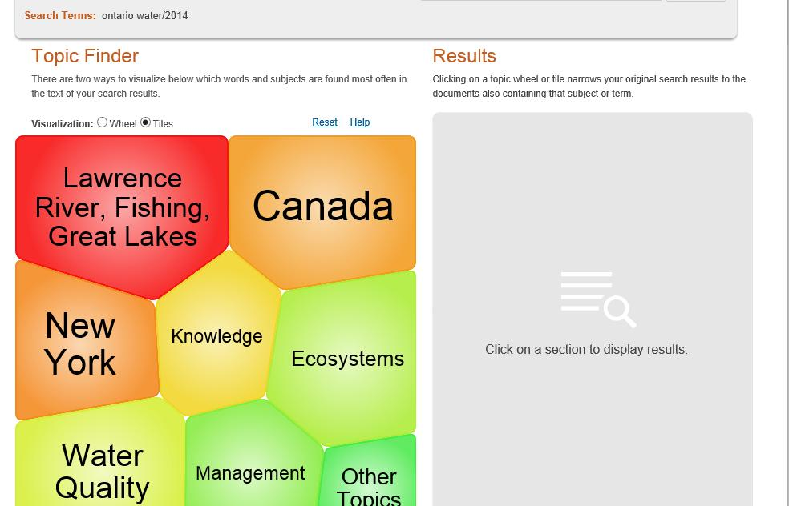
Same topic, seen in ‘tile’ option …
(‘Canada’ is the most specific term to click for this search)

Slide 8
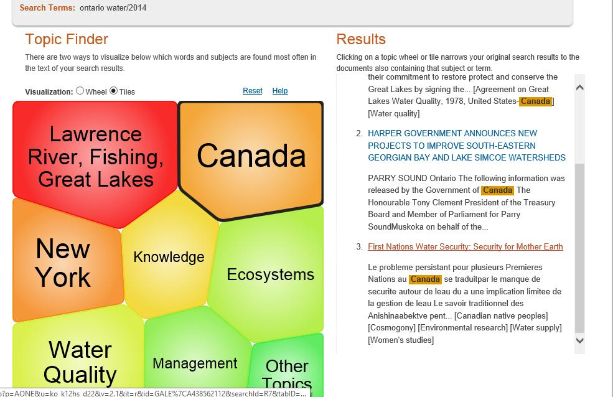
Once ‘Canada’ is clicked, here’s what happens …
(The topic finder found 3 results matching the search terms – there is a very informative, recently published article among them.)

Slide 9
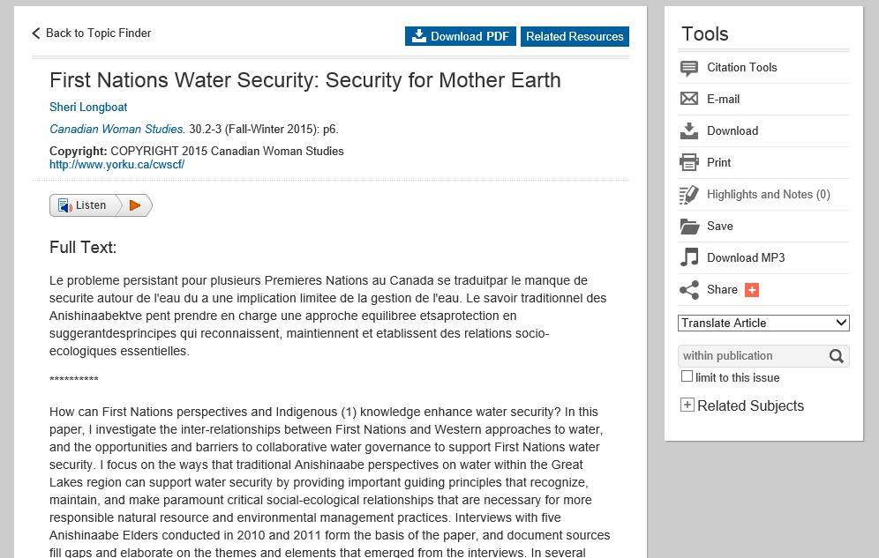
Lots of options presented …

Slide 10
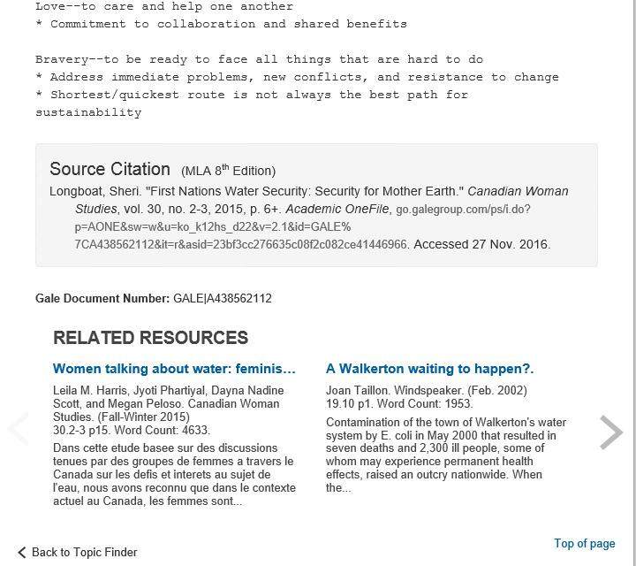
More options at the end of the article …

Slide 11
The End
Have a nice day ☺

